Slide 1
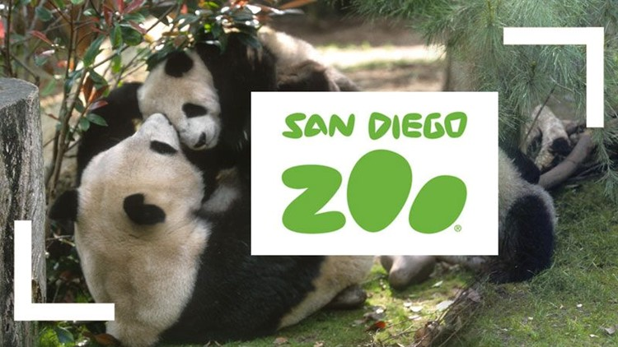
“THE FUTURE OF ZOOS” Laura Anastasia
RI 6.1-6.2
This week we are going to read a Scholastic Magazine article called “The Future of Zoos”. It talks about how zoos have changed over time and whether zoos are beneficial to animals. This articlew will present information from both sides of the argument.
Notes:
Teacher will set purpose for reading the article.
Option to initiate a small discussion: Survey students to see if they have visited a zoo.

Slide 2
Step 1: Vocabulary Map
One of the important words in our article is inhumane. People who criticize zoos think they are inhumane. Let’s look at what this word means in more detail.
Notes:
1. Teacher will set purpose for vocabulary map.

Slide 3
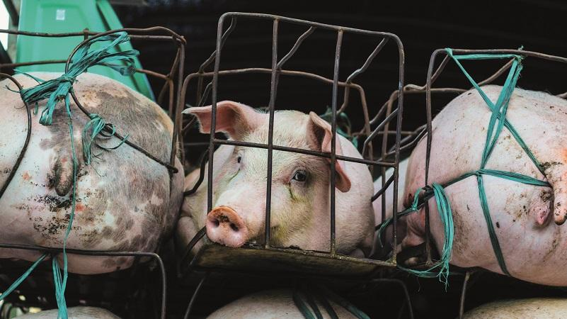
Inhumane (inhumana/o)
Definition: Something that is extremely cruel
How does this relate to inhumane?
Synonyms: unkind, heartless, brutal
Notes:
1. Introduce word and cognate (if applicable): This word is ____. What word? If you speak Spanish, you might be familiar with the Spanish word ______.
2. State definition: ___ means ____. What does ___ mean?
3. Discuss example: Use image to help explain the word.
4. Share synonyms with class

Slide 4
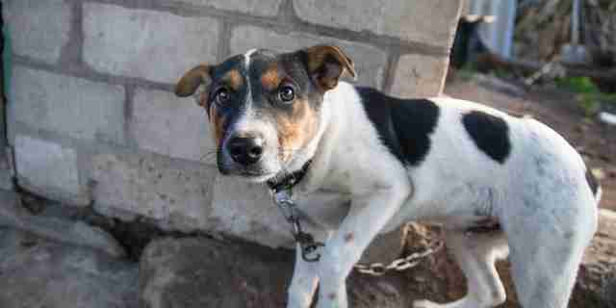
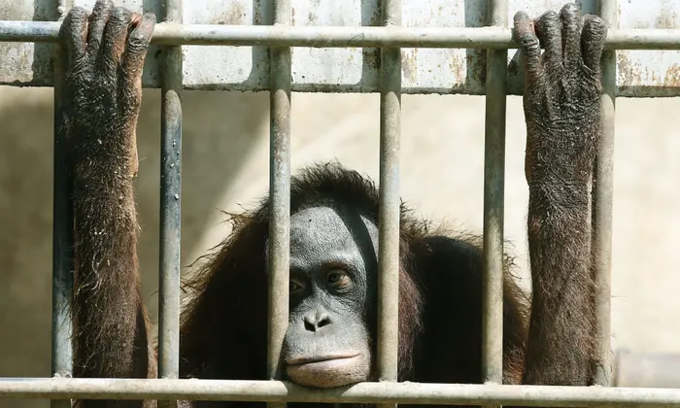
Inhumane
Definition: Something that is extremely cruel
Example Sentence 1
Example Sentence 2
It is inhumane to leave your dog tied up in hot weather without any water.
Zoo critics argue that zoos are inhumane to animals because the animals suffer from anxiety, boredom, and stress.
Notes:
1. Review example 1: (reading options: Teacher read, students follow; Choral Read; Cloze Read; Volunteer)
-Discuss how vocabulary word applies in scenario.
2. Review example 1: (reading options: Teacher read, students follow; Choral Read; Cloze Read; Volunteer)
-Discuss how vocabulary word applies in scenario.

Slide 5
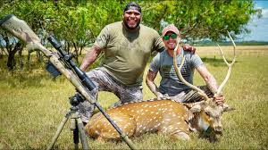
Inhumane: Turn and Talk
Definition: Something that is extremely cruel
1. Which of these do you think is inhumane? Why or why not?
- Children working in a factory for long hours.
- Hunting endangered animals for sport.
2. If you find an injured animal in the wild, is it inhumane to take him to live in a zoo away from his habitat OR to leave him to survive in the wild?
Notes:
1. Read Turn and Talk 1.
- Partner students
- Have partner 1 share their response. After 10-15 seconds, have partner 2 share their response.
- Bring class back together to discuss sample responses.
2. Read Turn and Talk 2.
- Partner students
- Have partner 1 share their response. After 10-15 seconds, have partner 2 share their response.
- Bring class back together to discuss sample responses.
Remember frequent and distributed practice supports long term retention and use of words.

Slide 6
Step 2: AR Guides Before Reading
Before we read our article “The Future of Zoos,” we are going to think about what we already know about zoos and react to some statements. This will help us to get ready to read and think critically about our text. Let’s take a look at our anticipation-reaction guide.
Notes:
1. Teacher will set purpose for and introduce the anticipation-reaction guide.

Slide 7
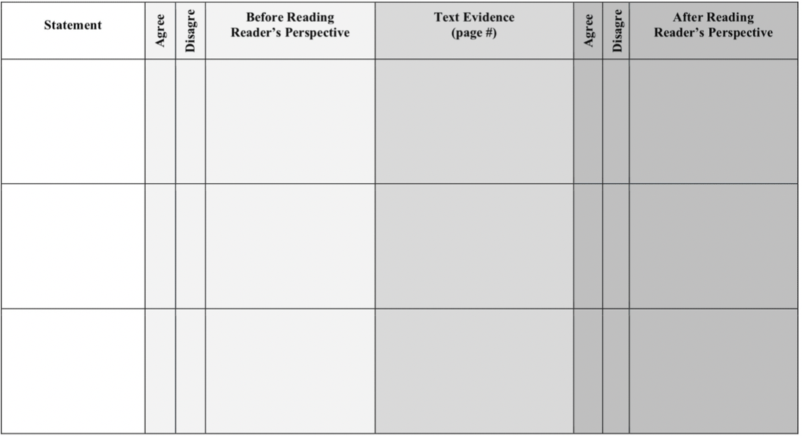
Introduce the AR Guide
Notes:
1. Introduce the Guide: This is our anticipation-reaction guide or AR guide for short.
Go ahead and write your name in the corner. We will use our AR over multiple days to take notes while we read. You will turn it in at the end of the week.
2. Review parts of the Guide: Let’s take a look at the parts of the AR first.
There are titles for each of the columns in the first row. Let’s read those out loud together.
3. Review the steps/process of the AR Guide:
We use the guide Before, During, and After Reading.
BEFORE READING
Read each statement on the AR Guide.
Then you decide whether you agree or disagree.
And, write your perspective or reason for agreeing or disagreeing with the statement.
DURING READING
As you read the article, you collect evidence to support or contradict the statement.
AFTER READING
At the end, you revisit your opinions and decide whether you still agree or disagree.
And, you write your perspective, or reason for agreeing or disagreeing with each statement.”

Slide 8
Let’s Read the Statements
The Future of Zoos by Laura Anastasia
Statement | Agree | Disagree | Reader’s Perspective Before Reading | Text Evidence (page #) | Agree | Disagree | Reader’s Perspective After Reading
Keeping animals in zoos is inhumane.
Zoo breeding programs have successfully protected endangered animals.
Zoos play an important role in animal conservation.
Notes:
Teacher Talk:
Before reading, take a look at the statements on this AR Guide about the treatment of animals in zoos. Decide if you agree or disagree with each statement. There is no right or wrong answer. Instead, you decide if you agree or disagree and why based on your own knowledge and experience. This will help you read and think critically about the text.
Read the statements:
- Let’s take a look at the statements for our article, “The Future of Zoos”
Statement 1: Keeping animals in zoos is inhumane.
Statement 2: Zoo breeding programs have successfully protected endangered animals.
Statement 3: Zoos play an important role in animal conservation.

Slide 9
Agree or Disagree & Explain our Perspective
BEFORE READING

Slide 10
Modeling Respond to Statements
The Future of Zoos by Laura Anastasia
Statement | Agree | Disagree | Reader’s Perspective Before Reading | Text Evidence (page #) | Agree | Disagree | Reader’s Perspective After Reading
Keeping animals in zoos is inhumane. |  | x | I think zoos treat animals well. They recreate their natural habitat and feed them their natural diet. Zoos also provide a home for animals that cannot go back to the wild.
Zoo breeding programs have successfully protected endangered animals. | x
Zoos play an important role in animal conservation. | x
Notes:
Model how to respond to Statement 1.
Teacher Talk: Let’s try Statement 1 together.
Read Statement.
Teacher Talk: Read Statement 1 in your head as I read it out loud, “Keeping animals in zoos is inhumane..”
B. Decide whether to Agree or Disagree
Teacher Talk: Hmmm, let me think about whether I agree or disagree with that statement. There is no right or wrong answer. I just make an answer based on what I already know.
Teacher Talk: I’m conflicted about this statement. I think animals should be allowed to be wild. But, I also think zoos do their best to recreate an animal’s natural habitat and feed them their natural food. Sometimes zoos are housing animals that no longer have a home in the wild. What do I know about inhumane? Well, I think that zoos treat animals well. So I’m going to disagree with that statement.
C. Write Your Perspective
Teacher Talk: Now what is my perspective (or reason)? Zoos recreate their natural habitat and feed them their natural diet. Zoos provide a home for animals that cannot go back to the wild. Let’s write that in the box.

Slide 11
Before Reading Guided Practice Respond to Statements
The Future of Zoos by Laura Anastasia
Statement | Agree | Disagree | Reader’s Perspective Before Reading | Text Evidence (page #) | Agree | Disagree | Reader’s Perspective After Reading
Keeping animals in zoos is inhumane. |  | x | I think zoos treat animals well. They recreate their natural habitat and feed them their natural diet. Zoos also provide a home for animals that cannot go back to the wild.
Zoo breeding programs have successfully protected endangered animals. | x |  | I agree because in the news I’ve heard about zoos protecting endangered species like the giant panda and the California Condor.
Zoos play an important role in animal conservation. | x
Notes:
Practice Statement 2 together.
Read Statement.
Teacher Talk: Now, let’s read Statement 2 together, “Zoo breeding programs have successfully protected endangered animals.”
B. Decide whether to Agree or Disagree.
Teacher Talk: Do we agree or disagree with that statement? Remember, there is no right or wrong answer. We just think about what we already know about zoos and extinction. What do we think?
C. Write Your Perspective.
Teacher Talk: Now, let’s try to explain why. One reason I agree is because of things I’ve read or heard in the news, so I’m going to write down information about that”. Think about why you might agree or disagree.

Slide 12
Independent Practice Respond to Statements
The Future of Zoos by Laura Anastasia
Statement | Agree | Disagree | Reader’s Perspective Before Reading | Text Evidence (page #) | Agree | Disagree | Reader’s Perspective After Reading
Keeping animals in zoos is inhumane. |  | x | I think zoos treat animals well. They recreate their natural habitat and feed them their natural diet. Zoos also provide a home for animals that cannot go back to the wild.
Zoo breeding programs have successfully protected endangered animals. | x |  | I agree because in the news I’ve heard about zoos protecting endangered species like the giant panda and the California Condor.
Zoos play an important role in animal conservation. | x |  | I agree because I’ve read other articles about zoo breeding programs, zoos supporting animal research, and zoos educating the public.
Notes:
Let students try Statement 3 on their own.
Read Statement.
Teacher Talk: Now you read Statement 3 and take a moment to think about whether you agree or disagree. Based on your own personal experience or other things you’ve read about the treatment of animals in zoos, do you agree or disagree with this statement? Think about how to explain your opinion to someone else, especially someone who might not think the same way you do?
B. Decide whether to Agree or Disagree & Write Your Perspective
Teacher Talk: Turn to your shoulder partner. Share your response. “I agree/disagree with this statement because ____.”
Teacher Talk: Let’s hear some answers from the group.

Slide 13
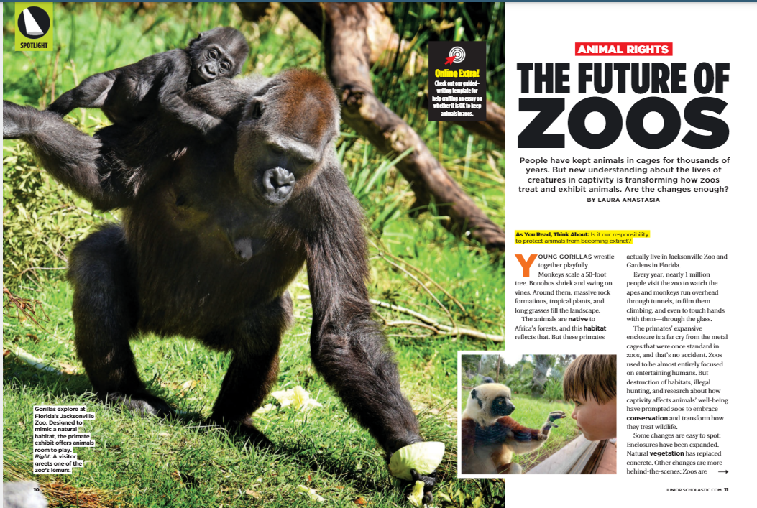
Step 3: Read the Article
Now we get to read our article “The Future of Zoos.” As we read, let’s think about our statements. There might be certain parts of the article that will help us understand the statements better.
Notes:
Teacher Talk: Now we get to read our article The Future of Zoos. As we read, let’s think about our statements. While reading, it’s our job to find any text evidence that supports or refutes our statements. We will pause periodically to think about new information and how it’s related to our statements. We can use our AR Guides to record evidence related to our statements as we read and record the page number where the evidence was found.
Teacher will guide students through a first read of the article.
Pause to initiate discussions around central ideas.

Slide 15
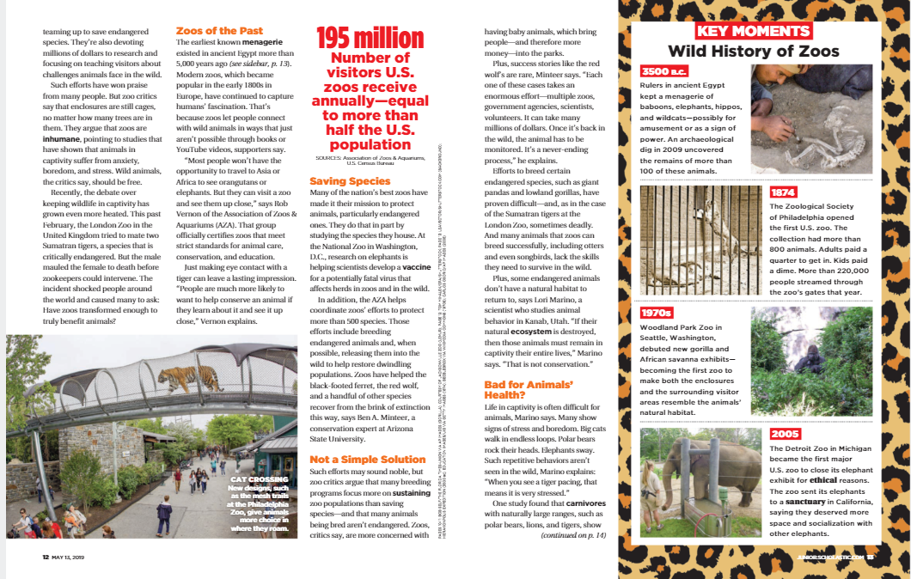

Slide 16
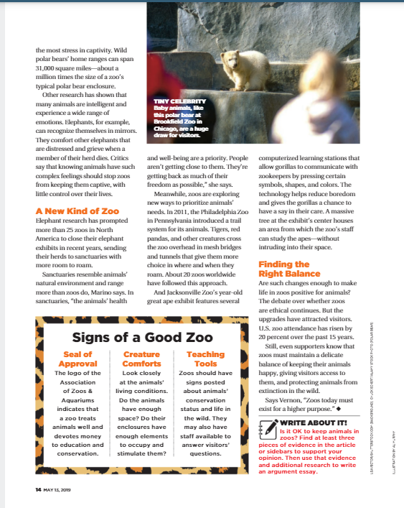

Slide 17
Step 4: Find the Evidence
Our job is to find any text evidence that supports or contradicts the statements in the AR Guide. We will write the evidence and page number on the chart.
Notes:
1. Teacher will guide students through how to collect evidence about a statement.

Slide 18
During Reading Gather Text Evidence
The Future of Zoos by Laura Anastasia
Statement | Agree | Disagree | Reader’s Perspective Before Reading | Text Evidence (page #) | Agree | Disagree | Reader’s Perspective After Reading
Keeping animals in zoos is inhumane. |  | x | I think zoos treat animals well. They recreate their natural habitat and feed them their natural diet. Zoos also provide a home for animals that cannot go back to the wild. | "[Critics] argue that zoos are inhumane. They point to studies that have shown that animals in captivity suffer from anxiety, boredom, and stress." (p.12)
Zoo breeding programs have successfully protected endangered animals. | x |  | I agree because in the news I’ve heard about zoos protecting endangered species like the giant panda and the California Condor.
Zoos play an important role in animal conservation. | x |  | I agree because I’ve read other articles about zoo breeding programs, zoos supporting animal research, and zoos educating the public.
Notes:
So, I think this is related to the statement that zoos are inhumane. I’m going to record my evidence and the page number on my guide.

Slide 19
AR Guide: “The Future of Zoos” Practice
Statement | Agree | Disagree | Reader’s Perspective Before Reading | Text Evidence (page #)
Keeping animals in zoos is inhumane. |  |  | I think zoos treat animals well. They recreate their natural habitat and feed them their natural diet. Zoos provide a home for animals that cannot go back to the wild. | "[Critics] argue that zoos are inhumane. They point to studies that have shown that animals in captivity suffer from anxiety, boredom, and stress." p.12
Zoo breeding programs have successfully protected endangered animals. |  |  | I agree because in the news I’ve heard about zoos protecting endangered species like the giant panda and the California Condor. | The AZA helps coordinate zoos’ efforts to protect more than 500 species. Those efforts include breeding endangered animals. And, when possible, zoos release those animals into the wild. This helps restore populations. P.12 … the London Zoo tried to mate Sumatran tigers which are critically endangered, but the male mauled the female to death before the zookeepers could stop it. P.12
Zoos play an important role in animal conservation. |  |  | I agree because I’ve read other articles about zoo breeding programs, zoos supporting animal research, and zoos educating the public. | Many zoos make it their mission to protect animals, especially endangered ones. They study species. At the National Zoo research on elephants is helping to develop a vaccine for a fatal virus. P.12 Zoos are spending millions of dollars of research. And to teach visitors about challenges animals face in the wild. P.12
Notes:
Practice completing the text evidence column of the AR Guide:
Let’s look at Statement 1, “Keeping animals in zoos is inhumane..” I am going to go back to the beginning of the article and read to see if there is information about whether zoos are inhumane.
On the 1st column of pg 12, it says that critics argue zoos are inhumane. How are they inhumane? Let’s write that in our box.
Keep reading, what do zoo critics think of zoos? Does that fit with being inhumane? Let’s write that in our box.
We have lots of information for this statement so let’s move to the next.
Statement 2 says, “Zoo breeding programs have successfully protected endangered animals.” Is there a specific section in our text that talks about zoos breeding endangered animals? Let’s look within those sections for information about this statement.
How are their actions successful? Let’s write that information down.
How are their actions unsuccessful? Let’s write that information down.
We have lots of information for this statement so let’s move to the next.
Read Statement 3 to me. Is there a specific section in the text that talks about zoos and animal conservation?
Read those sections by yourself. Then, write down the evidence you find about animal conservation.
Now, share your evidence with your shoulder partner.
Let’s hear some evidence from the group.

Slide 20
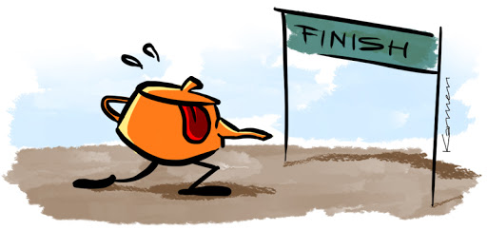
Step 5: Final Perspective
Almost finished! Our last job is think about our reading and all of our text evidence. Then, we can write our final perspective on the statement.
Notes:
3. Teacher will guide students through the final perspective after reading.

Slide 21
AR Guide: “The Future of Zoos” Practice
Statement | Agree | Disagree | Reader’s Perspective Before Reading | Text Evidence (page #) | Agree | Disagree | Reader’s Perspective After Reading
Keeping animals in zoos is inhumane. |  |  | I think zoos treat animals well. They recreate their natural habitat and feed them their natural diet. Zoos provide a home for animals that cannot go back to the wild. | "[Critics] argue that zoos are inhumane. They point to studies that have shown that animals in captivity suffer from anxiety, boredom, and stress." p.12 |  |  | I changed my mind because the article talked about animals showing many signs of distress like pacing back and forth from boredom.
Zoo breeding programs have successfully protected endangered animals. |  |  | I agree because in the news I’ve heard about zoos protecting endangered species like the giant panda and the California Condor. | The AZA helps coordinate zoos’ efforts to protect more than 500 species. Those efforts include breeding endangered animals. And, when possible, zoos release those animals into the wild. This helps restore populations. P.12 … the London Zoo tried to mate Sumatran tigers which are critically endangered, but the male mauled the female to death before the zookeepers could stop it. P.12 |  |  | I’m conflicted about this, but I think I now disagree because I don’t think zoos are successful if their breeding program results in endangered animals killing one another.
Zoos play an important role in animal conservation. |  |  | I agree because I’ve read other articles about zoo breeding programs, zoos supporting animal research, and zoos educating the public. | Many zoos make it their mission to protect animals, especially endangered ones. They study species. At the National Zoo research on elephants is helping to develop a vaccine for a fatal virus. P.12 Zoos are spending millions of dollars of research. And to teach visitors about challenges animals face in the wild. P.12 |  |  | I agree even more now. I didn’t realize that zoos were also involved in developing vaccines.
Notes:
Practice completing the perspective after reading column of the AR Guide:
I am going to form my final perspective on Statement 1.
To do this, I must read through the entire row of information on the statement. I start with the statement, whether I agreed or disagreed, my first perspective, and all the text evidence.
Teacher will read through this information with class participation as needed.
Now I ask myself, do I still agree or disagree? What is my perspective on the statement now?
When I think about something that is inhumane, I think of something that is exceptionally cruel and brutal. I think the signs of distress animals show in zoos is cruel, so I’m going to write that down. I will write this down in the box.
Now, let’s work together to form our final perspective for statement 2.
Let’s read the entire row of information.
Do we still agree? What is our perspective now?
Remember, there is no right or wrong answer. We just think about what we already know about zoos and extinction. What do we think? Let’s write the answer in the box.
Now you form your final perspective on statement 3.
Read the entire row of information by yourself.
Make your decision on whether you still agree or disagree.
Write your perspective down.
Give students 5-7 minutes to respond.
Turn to your shoulder partner. Share your response. “After reading, I think that ____.”
Let’s hear some answers from the group.

Slide 22
After Reading Independent Practice Statement 3
The Future of Zoos by Laura Anastasia
Statement | Agree | Disagree | Reader’s Perspective Before Reading | Text Evidence (page #) | Agree | Disagree | Reader’s Perspective After Reading
Keeping animals in zoos is inhumane. |  | x | I think zoos treat animals well. They recreate their natural habitat and feed them their natural diet. Zoos also provide a home for animals that cannot go back to the wild.
Zoo breeding programs have successfully protected endangered animals. | x |  | I agree because in the news I’ve heard about zoos protecting endangered species like the giant panda and the California Condor.
Zoos play an important role in animal conservation. | x |  | I agree because I’ve read other articles about zoo breeding programs, zoos supporting animal research, and zoos educating the public.
Notes:
Let students try Statement 3 on their own.
Read Statement.
Teacher Talk: Now you read Statement 3 and take a moment to think about whether you agree or disagree. Based on your own personal experience or other things you’ve read about the treatment of animals in zoos, do you agree or disagree with this statement? Think about how to explain your opinion to someone else, especially someone who might not think the same way you do?
B. Decide whether to Agree or Disagree & Write Your Perspective
Teacher Talk: Turn to your shoulder partner. Share your response. “I agree/disagree with this statement because ____.”
Teacher Talk: Let’s hear some answers from the group.

